Slide 1
SDC SYNOPSYS DESIGN CONSTRAINTS

Slide 2
What is SDC: SDC is a format used to specify the design intent, including the timing, power and area constraints for a design. SDC is TCL based.
Tools used this format: DC(Design compiler, ICC (IC compiler), Prime Time(PT)
Information In the SDC: There are mainly 4 types of the information.
1.The SDC version
2. SDC units
3.Design Constraints
4.comments

Slide 3
Attributes in SDC:
Clock &attributes
Create clock, Create virtual clock, Create generated clock, clock latency, clock uncertainity.
Input & output delay
Set input delay , set output delay
DRV’s
Max transition, Max capacitance, Max fanout
Timing Exceptions
Multicycle path, false path, max delay, min delay,
Half cycle path, set case, set disable

Slide 4
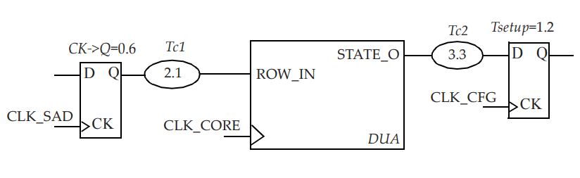
Clock &attributes :
create_clock -period 10 -waveform {0 5} [get_ports MIICLK]
create_generated_clock -name MIICLKDIV2 -source MIICLK \ -edges {1 3 5} [get_pins UMIICLKREG/Q]
create_clock -name VIRTUAL_CLK_SAD -period 10 -waveform {2 8}
Master clock:
A generated clock is the one that is derived from another clock, known as its master clock.

Slide 5
set_clock_latency -source -rise 0.7 [get_clocks CLKM]
set_clock_latency -source -fall 0.65 [get_clocks CLKM]
set_clock_uncertainty -setup 0.2 [get_clocks CLK_CONFIG]
set_clock_uncertainty -hold 0.05 [get_clocks CLK_CONFIG]

Slide 6
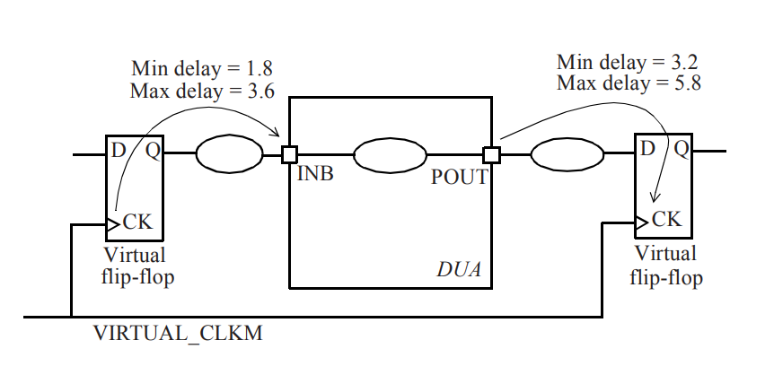
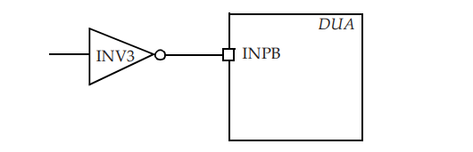
Input & output delay:
set_input_delay -clock VIRTUAL_CLKM \ -max 3.6 [get_ports INB]
set_output_delay -clock VIRTUAL_CLKM \ -max 5.8 [get_ports POUT]
set_input_transition -rise 0.3 [get_ports CLKM]
set_driving_cell -lib_cell INV3 -library slow [get_ports INPB]

Slide 7
DRV’s
set_max_transition 0.15 [get_clocks {SD_DDR_clkn}] –clock _path
set_max_fanout 0.5 [get_clocks {SD_DDR_clkn}] –clock _path
set_max_capacitance 0.9 [get_clocks {SD_DDR_clkn}] –clock _path

Slide 8
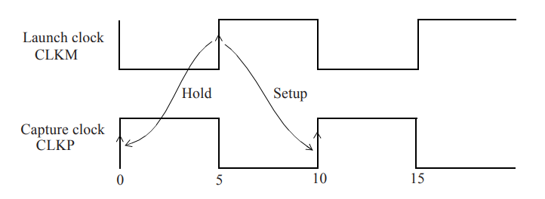
Timing Exceptions :
In such cases, the combinational path is declared as a multicycle path.
set_multicycle_path 3 -setup -from [get_pins UFF0/Q] \ -to [get_pins UFF1/D]
Set_multicycle_path 2 -hold -from [get_pins UFF0/Q] \ -to [get_pins UFF1/D]
set_false_path -from [get_clocks SCAN_CLK] \ -to [get_clocks CORE_CLK]
set_false_path –through [get_pins UMUX0/S]
Half cycle path:
create_clock -name CLKM -period 10 -waveform {5 10} [get_ports CLKM]
create_clock -name CLKP -period 10 -waveform {0 5} [get_ports CLKP]

Slide 9
Max delay & min delay
set_max_delay 0.45 -from UMUX0/Z -through UAND1/A -to UOR0/Z
# Sets max delay for the specified paths.
set_min_delay 0.15 -from {UAND0/A UXOR1/B} -to {UMUX2/SEL}
Timing constraints :
set_load 5 [get_ports OUTX]
set_case_analysis 1 func_mode[0]
set_disable_timing -from S -to Z [get_cells UMUX0]
Group path:
group_path [-name group_name] [-default] [-weight weight_value]
[-from from_list] [-rise_from from_list] [-fall_from from_list]
[-to to_list] [-rise_to to_list]
[-fall_to to_list] [-through through_list]
[-rise_through through_list] [-fall_through through_list]
# Gives a name to the specified group of paths.

Slide 10
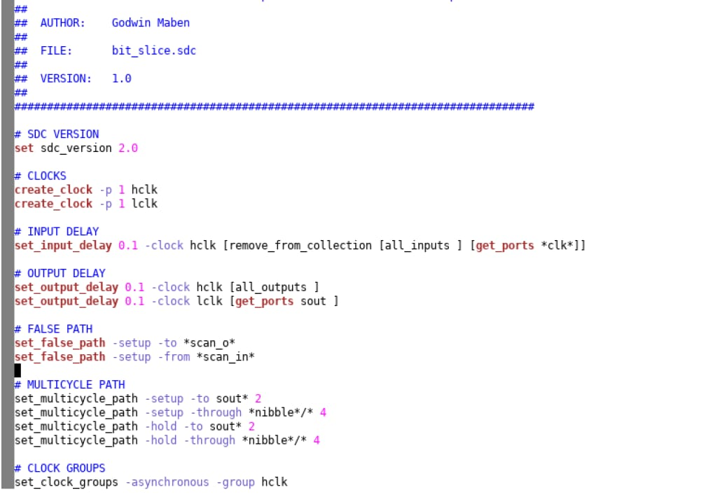

Slide 11

This Photo by Unknown Author is licensed under CC BY-SA

